Slide 1
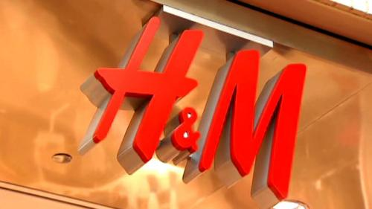
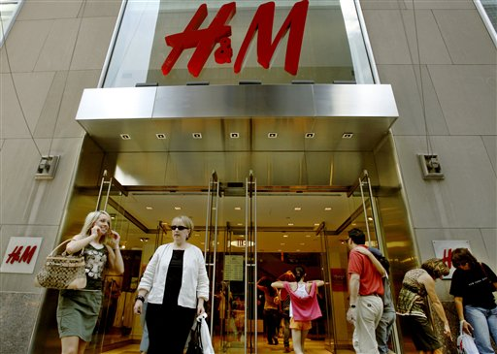
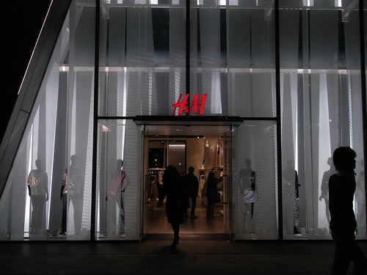
Alex
Nici
Brandi

Slide 2
H & M Overview
H&M opened its first store in Sweden in 1947, and is now represented on more than 40 markets. H&M’s designers create a broad and diverse range of fashion for men, women, youth and children.
Every year, H&M launches a number of major campaigns, complemented by smaller additions. The campaigns act as exciting invitations to the H&M brand. Since 2004, H&M has also collaborated with international designers and fashion icons such as Karl Lagerfeld, Stella McCartney, Versace and Marni. The designer collaborations boost the H&M brand by creating buzz and making the basic business concept of fashion and quality at the best price clearer to customers.
Today almost 2,600 stores are spread across 44 markets. The H&M Group includes H&M and H&M Home as well as COS, Monki, Weekday and Cheap Monday.

Slide 3
Job Analysis
Corporate Governance
Effective corporate governance is about ensuring that companies are run as efficiently as possible in the interests of the shareholders. H&M applies the Swedish Code of Corporate Governance.

Slide 4
Job Analysis
Board of Directors
The Board of Directors manages the company’s affairs on behalf of the shareholders. It consists of eight ordinary members, two employee representatives with two deputies for these positions.

Slide 5
Job Analysis
Managing Director
Karl-Johan Persson, born in 1975, has been the Managing Director and Chief Executive Officer of H & M Hennes & Mauritz AB since 1 July 2009.

Slide 6
Job Description
The new Designer Collection Manager at H&M will be under the guidance of the District Manager as well as the Store Manager. The Designer Collection Manager will provide knowledge of featured guest designers and brands to staff and customers. They will also be responsible for designing, set up, and managing staff on how to arrange the guest designer’s collection, and oversee the upkeep of the merchandise in the collaboration department or section of the store.
In addition, the Designer Collection Manager will be responsible for maximizing sales and drive profitability in guest designer collaborations merchandise. Thus, in order to guarantee that the products are properly priced and displayed in the manner it was intended to be revealed. This new position must meet deadlines as well as follow, execute, and manage employees in safety and security procedures.

Slide 7
Recruitment
Recruitment sources will be through the H&M Web site in the “Work at H&M” section. Other sources will be in newspapers and websites such as: WGSN, Women’s Wear Daily (WWD), and StyleSight. H&M will be recruiting from the company’s website since most of the recruitment H&M does already is through their website or promoting within the organization.
The company will be utilizing newspapers such as Women’s Wear Daily as well, due to many upper level positions that are often advertised through this type of media.
Another recruitment source will be social media websites such as Facebook to recruit for the new position for the reason that utilization of technology and social media websites are a popular way to gain attention and get information out quickly.

Slide 8
Compensation
The compensation is based off of the level of education, knowledge, skill, and experience necessary to perform the job.
It is also based off the store location the employee will be assigned to work at, and the economy since the cost of living has to been considered.
In addition, the compensation is based off of the pre-existing salaries at H&M listed on the web site: Glassdoor.com. This job position would be classified under the Department Managers section of the organization.
Other Considerations:
The salary will be paid to the Designer Collection Manager every two weeks. This position is not a contract position with H&M. The overall employment is considered an “at will” relationship, meaning there is freedom to resign given a two week notice. Conversely, H&M is permitted to terminate the Designer Collection Manager from their position with or without cause and with or without notice for any reason.
Position: Designer Collection Manager
Wage: Salary, Non-Exempt: $4,000 a month; $48,000 a year

Slide 9
Interview
Screening Interview:
A screening interview will be done by the Store Manager on all applicants who are being considered. The screening interview will consist of a brief telephone interview. The applicant’s information will be verified and if all goes well, the applicant will be invited to be interviewed by the Store Manager in person at a scheduled date and time.
Interview:
The interviews will be conducted by the Store Manager. The interview itself will be a structured interview. The Manager will have situational and behavioral questions to ask the applicant, but they are not required to strictly stick to the interview questions.
Final Screening:
Once all the applicants that are being considered are interviewed, the Manager will do reference and background checks on the best possible candidates left. This final screening part of the interview process should aid in narrowing down the best applicants even more and get more information on the applicants previous work experience. The Manager will ultimately make the final hiring decision with support from the Visual Merchandiser.
Rating Scale:
There will be a scoring system in place for how to rate the candidates responses and answers to the question’s they are asked in the interview.
- Screening Interview
- Interview
- Final Screening
- Rating Scale

Slide 10
Rewards/Retention
H&M offers all employees a profit sharing plan called “HIP,” which is part of H&M incentive plan.
H&M’s end goal in doing this is to ensure that all employees benefit from the growth of the company just as the shareholders would, so everyone in the organization is working as a team towards improving and growing the company and brand.
The amount of shares the employees are entitled to are to be solely based on their HIP working hours.
The pay-out of funds for the HIP incentive program will began when employees reach 62 years of age.
H&M believes that our employees are crucial to the company’s success and provides incentive programs including the long-term HIP H&M Incentive Program in order to demonstrate to employees our appreciation, as well as maintaining long-term employee commitment to the company.

Slide 11
Retention Cont.
Medical, dental & vision coverage
Domestic Partner Health Coverage
Wellness Days
Vacation Package
Paid holidays by H&M including the employees birthday
Employee discounts
Commuter Benefits including parking & transit
Short & long-term disability
Maternity & Parental Leaves
401K Retirement plan with a company match
Jury Duty leave
Worldwide Travel Assistance Program
Life Insurance and Accidental Death (100% company paid)
Supplemental Life Insurance
Employee Assistance Program
Flexible Spending Accounts (Comes with promotional opportunities in doing collaborations at other H&M store locations.)
Bereavement Time
Pet Insurance
Working Advantage Discount Program
Global Fit (Fitness Club Program)
Hyatt Group Legal Plan
Met Life Auto / Home Insurance
H&M offers benefit packages to all employees to show our appreciation for all their hard work and dedication.

Slide 12
Performance Management
Assessment
Performance Mgmt Methods
A performance assessment will be issued twice per year, once mid-year and the second will be issued at the end of the fiscal year. The assessment will provide specific details pertaining to the expectations of the job and goals for future performance.
The second performance assessment that is processed at the end of the fiscal year allows for merit increases to be awarded accordingly. This assessment provides an individual performance and economic determinant to guide the employee to increase their potential.
A combination of performance management methods will be utilized to assess the employee. A result based approach will be used to represent their performance dimension in an objective manner.
This will measure the quality of the employee’s performance by showing how well they act upon the production delivery process of the designer’s collection.
Another approach will be the 360 degree method. It will be utilized to gather information on the employee’s performance data from as many sources as possible including: actual designer and their design team, regional H&M managers, store managers, co-workers, employees working in the collection department, and customers. T
There will be two different surveys: one for the designer, their team, and the H&M district manager and an additional questionnaire for co-workers and customers.

Slide 13
Performance Management Cont.
Feedback Mechanisms
Growth/Development Plans
The potential action plans the District Manager will take to improve the development and performance of the designer collection manager are among the following:
Supervisor will evaluate the cause of any poor performance and implement workshops and training development activities relative to where the inadequate performance was present.
Evaluate work ethic and job design to see if it aligns with the specified description. Changes may need to be made to the job description as the company grows and the employee’s position enhances the company’s sales.
Possible technology solutions will be taken into account, in regards to communication, utilizing web cameras for meeting across the state or country, changing the frequency of meetings, re-organizing store design relative to where the designer’s collection is located and how the apparel and merchandise is displayed.
Addressing the measured quality of employee’s performance compared to the past performance of the designer’s collection and creating graphical charts with future goals.
The assessment will be given twice a year, two weeks after the collection debut. Feedback from the assessment will be provided four weeks after it has been given out. Results will be discuss in a formal meeting with a district supervisor.
A review of the standards of their performance will ensure they are fully knowledgeable and informed of how to be successful in this position.
New target goals and objective with new deadlines will be established during the formal meeting between the supervisor and employee.
At the annual performance assessment the manager will receive feedback from employee peers and business partners they encounter through the “Business Partner Feedback” program. This feedback will play a vital role in bringing awareness to the employee on how well they are doing their job and what can be improved upon.

Slide 14
Final Thoughts
Questions or Comments?

Slide 15
Citation
H&M Web site. 2012. Retrieved from: http://www.hm.com/us/
O*NET Online Website. 2012. Retrieved from: http://www.onetonline.org/
Lepak, David, Mary Gowan. Human Resource Management, 1/e XML Vitalsource eBook for EDMC. 1. VitalSource Bookshelf. Pearson Learning Solutions, 03/2012, July 23, 2012. http://digitalbookshelf.artinstitutes.edu/books/9781256650300
2012. H&M Salary. Glassdoor.com. Retrieved from: http://www.glassdoor.com/Salaries/hm-salary-SRCH_KE0,2.htm

